Slide 1



CINEA/EMFAF/2021/3.1.2/03/SC04/SI2.881222
Specific Contract 2021/3.1.2/03/SC04
Hosting, maintenance and further development of the Regional Database for the Mediterranean and Black Seas
Liaison Meeting
September 2023
Brussels

Slide 2
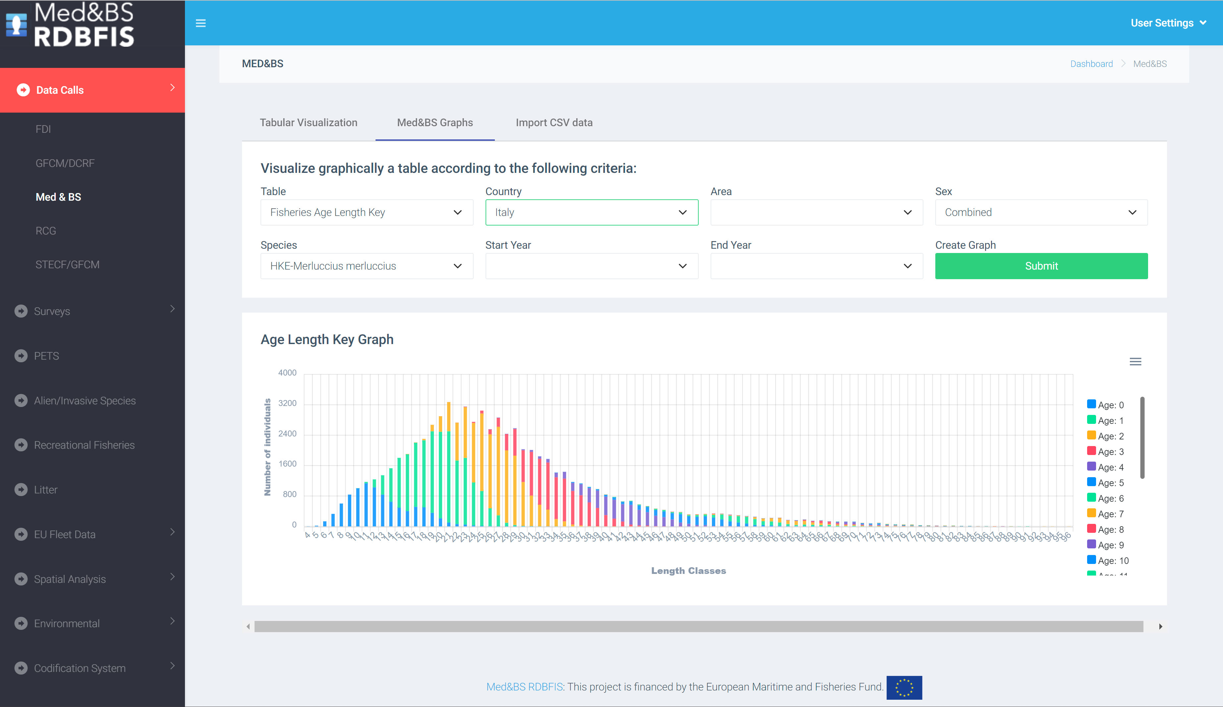
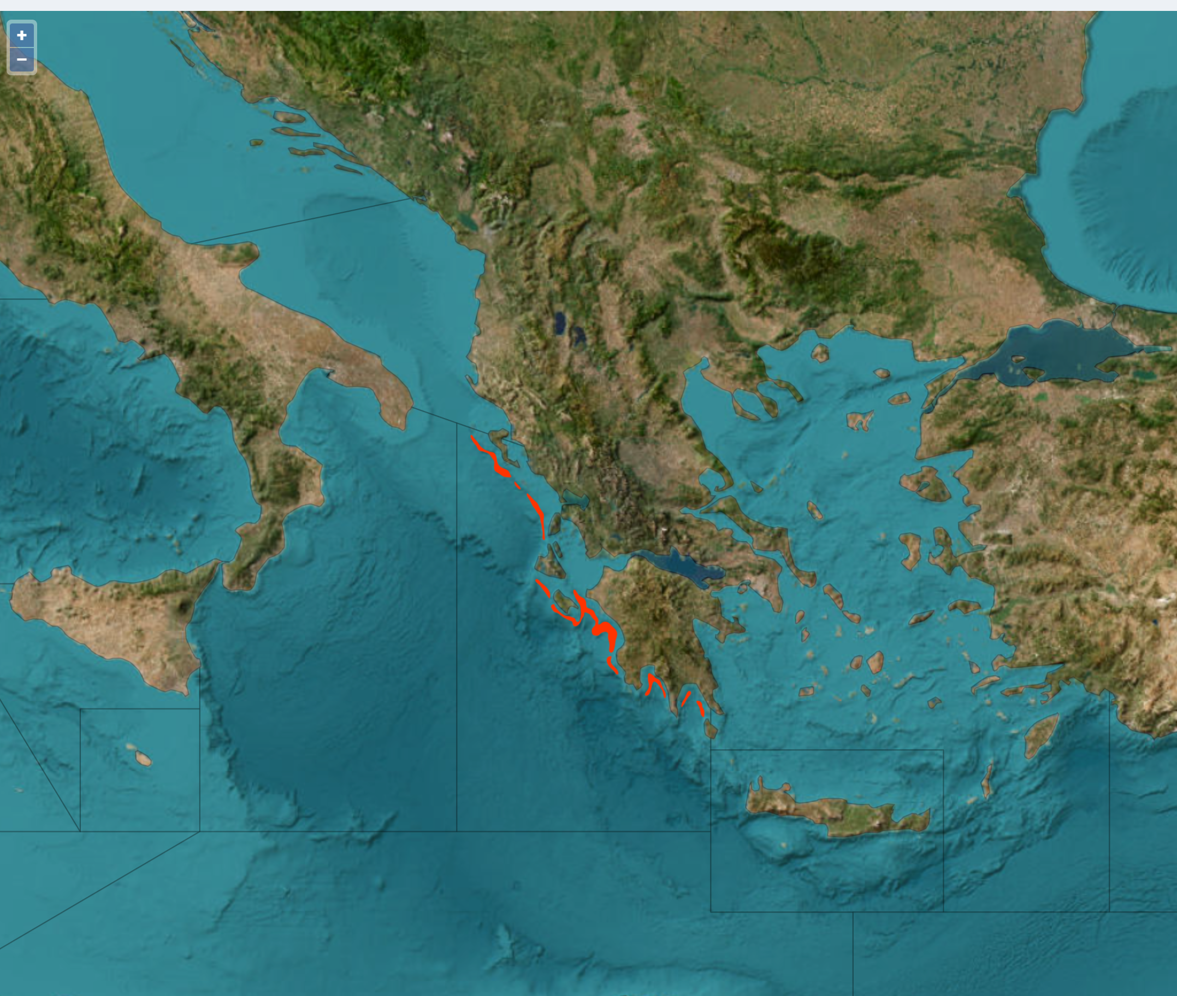
Med&BS RDBFIS: overview
RDBFIS: a web-based integrated fisheries information system for the Med&BS
main features and advantages:
Centralize RDB for DCF data;
A power full tool for Med&BS RCG, Med&BS MS, end users;
A security subsystem ensures data access and protection;
Support common quality data checks, processing, reporting;
Surveys are included;
Spatial information has been integrated
https://medbs-rdbfis.hcmr.gr:8443
Notes:
The current project worked closely with all involved parties, namely the Regional Coordination Group Mediterranean & Black Sea, Member States of the marine region, survey coordination groups, JRC, DG MARE, other MARE/2020/08 regional grants, end users, RDBES. The outcome - RDBFIS – satisfies all identified needs expressed so far to the extent possible, while, proposing options and functionalities that could bring added value to the core tasks of the regional database Mediterranean and Black Seas. DG MARE considers that the product of the regional grant RDBFIS forms a solid basis for setting up a regional database.

Slide 3














Med&BS RDBFIS: overview
Open source in information technologies were fully adopted (2020-2023 EC strategy ‘’Think Open’’)¹
¹
RDBMS: PostgreSQL
Spatial and geographic objects: PostGIS, Geoserver, Map objects
Graphical interface for the front end of the platform: Angular Web Application Framework
Back end of the platform: Spring Framework
Authentication & Authorization: Spring Security OAuth2 & JSON Web Token
Web Application Server: Apache Tomcat
Persistence: Hibernate Object Relational Mapping library
Programming: R and Python programming languages
Libraries/Packages: R libraries for statistical computing and graphics
The RDBFIS was developed in the Hellenic Centre for Marine Research (HCMR);

Slide 4
Med&BS RDBFIS follow up project
Hosting*, maintenance and further development of the Regional Database for the Mediterranean and Black Seas
Under FRAMEWORK CONTRACT – EASME/EMFF/2020/OP/0021
Duration: 24months, Project Start: April 1st 2023
Purpose of the project
The main aim of the study is to work on the hosting, maintenance, fine-tuning and further development of the end product of regional grant RDBFIS and to provide support to the users of the end product.
As a follow up to the RDBFIS grant and taking into account that a solution for permanent hosting is currently lacking -COM proposes a temporary solution for hosting for the next two years.
* Three options have been elaborated so far: JRC, GFCM and ICES. The MS and the RCG Med & BS expressed preferences for JRC and GFCM, whereas ICES was not favoured. COM later announced that JRC is no longer an option for hosting.
Notes:
The turning point of this end product will be the population of the database with data coming from the Member States of the marine region and the use of RDBFIS by Member States to respond to standard DG MARE data calls and other recurrent requests and reporting obligations. RDBFIS will be further developed under the Framework Contract Mediterranean and Black Seas (EASME/2020/OP/0021). More concretely, specific Contract N°04 - CINEA/EMFAF/2021/3.1.2/03/SC04/SI2.881222 – ‘Hosting, maintenance and further development of the regional database for the Mediterranean and the Black Sea’, implementing the framework contract, is expected to ensure the necessary follow up for the next two years”.

Slide 5
Med&BS RDBFIS follow up project
12 partners are involved in the development of the project
Hellenic Centre for Marine Research (HCMR)
Coispa Tecnologia & Ricerca Scarl (COISPA)
Consorzio per il Centro Interuniversitario di Biologia Marina ed Ecologia Applicata G. Bacci (CIBM)
Italian National Research Council (CNR) (Istituto per le Risorse Biologiche e le Biotecnologie Marine (CNR-IRBIM) and Istituto per il Rilevamento Elettromagnetico dell’Ambiente (CNR-IREA))
Nisea società cooperativa (NISEA)
University of Athens (UOA)
University of Thessaly (UTH)
Hellenic Agricultural Organization Demeter (HAO Demete)
Ministry of Agriculture, Rural Development and Environment of Cyprus - Department of Fisheries and Marine Research, Republic of Cyprus (DFMR)
National Institute for Marine Research and Development "Grigore Antipa" (INCDM)
Institute of Oceanography and Fisheries (IOF)
Institute of Oceanology BAS (IO-BAS)
Non-partners with a significant contribution
Executive Agency for Fisheries and Aquaculture, Bulgaria (Simona Vasileva NICHEVA)
Ministry of Agriculture, Directorate of Fisheries, Croatia (Ivana VUKOV)
Fisheries Research Unit, Department of Fisheries and Aquaculture, Malta (Jurgen Mifsud
Notes:
The turning point of this end product will be the population of the database with data coming from the Member States of the marine region and the use of RDBFIS by Member States to respond to standard DG MARE data calls and other recurrent requests and reporting obligations. RDBFIS will be further developed under the Framework Contract Mediterranean and Black Seas (EASME/2020/OP/0021). More concretely, specific Contract N°04 - CINEA/EMFAF/2021/3.1.2/03/SC04/SI2.881222 – ‘Hosting, maintenance and further development of the regional database for the Mediterranean and the Black Sea’, implementing the framework contract, is expected to ensure the necessary follow up for the next two years”.

Slide 6
Med&BS RDBFIS follow up project - Activities
To populate the system with data: To this end, the technical elements of a data call/ data request to be addressed to the relevant Member States and actors of the region, such as RFMOs will be drafted. DG MARE will assist in this process and follow up to ensure provision of the data. DG MARE will equally assist, if there is a need to access data from existing sources/databases. The requested datasets to be stored in the RDBFIS will refer to the period:
2002-2022 for Med&BS datacall,
2013-2022 for FDI datacall,
2017-2022 for GFCM/DCRF datacall,
Med&BS RCG data (DCR & DCF: fishing intensity, landings).
Detailed biological data
MEDIAS data
As the RDBFIS is fully operational, the Member States are invited to use the application to execute syntax and data quality control procedures and store the clean data into the system. A dedicated RDBFIS team will support this process through bilateral contacts and working jointly with Member States.
Notes:
The turning point of this end product will be the population of the database with data coming from the Member States of the marine region and the use of RDBFIS by Member States to respond to standard DG MARE data calls and other recurrent requests and reporting obligations. RDBFIS will be further developed under the Framework Contract Mediterranean and Black Seas (EASME/2020/OP/0021). More concretely, specific Contract N°04 - CINEA/EMFAF/2021/3.1.2/03/SC04/SI2.881222 – ‘Hosting, maintenance and further development of the regional database for the Mediterranean and the Black Sea’, implementing the framework contract, is expected to ensure the necessary follow up for the next two years”.

Slide 7
Med&BS RDBFIS follow up project- Activities
Further development:
A further improvement is concerning the consistency of data quality checks. Specifically, particular attention will be paid to enhancement of the quality checks considering the RDBES formats, focusing on the hierarchies applied in the Mediterranean for the biological samplings;
Concerning the MEDITS survey data, another improvement to be included in the RDBFIS is represented by the embedding of an upgraded BioIndex R package that provides relevant statistics on survey data, as biomass and density indices by year, length-frequency distributions, recruitment/spawner indices and maps;
The integration of MEDIAS survey into RDBFIS will be implemented with the assistance of MEDIAS chair and scientists;

Slide 8
Med&BS RDBFIS follow up project- Activities
Further development:
Data elaboration routines as well as data entry forms for stomach content, PETS, alien species, Eggs&Larvae and recreational fisheries is foreseen to be developed;
Fleet analysis: Considering that: (i) several components of the application will have open access and (ii) the usefulness of disseminating information about Europe's commercial fishing fleet, a dynamic tool will be developed portraying the evolution of fleet dynamics in Europe;
FDI spatial checks: R routines already implemented in JRC supporting the FDI EWG works, will be incorporated into RDBFIS. Discussions have started with the developers of R routines, a meeting was held discussing technical integration issues to RDBFIS;
Work Plan and Annual Reports: An effort will be made to enable Member States to send the Work Plan and Annual Reports online through a web based form. Syntax and consistency checks are foreseen to be implemented;

Slide 9
Med&BS RDBFIS follow up project- Activities
Further development:
Integration of fleet economic data;
The goal is to include as much as possible information collected in the FW of DCF into RDBFIS.
One of the advantage of including fleet economic data into RDBFIS is that quality checking and processing routines could be performed on the DCF data submitted in four datacalls (FDI, Med&BS, ECON, GFCM/DCRF) with the aim to decrease discrepancies.

Slide 10
Med&BS RDBFIS follow up project
Med&BS RDBFIS follow up project- Progress work
16th MEDIAS Coordination Meeting (April, participation)
MEDIAS Working Group meeting (May, participation)
RCG ECON Technical Meeting (May, participation)
MEDITS Coordination Group (May, participation)
EU fleet register data (May)
Improvement of the method to estimate FDI spatial fishing effort for SSF (based on fishing pressure index and MCDA) (August, Irida-Stefanos)
RDBFIS & FDI mapping group meeting (September)
Technical works related to hosting RDBFIS on HCMR (April - )
Preparation work for the 2nd MEDIAS WG
Internal meetings
Preparation of the datacall

Slide 11

CINEA/EMFAF/2021/3.1.2/03/SC04/SI2.881222
Specific Contract 2021/3.1.2/03/SC04
Hosting, maintenance and further development of the Regional Database for the Mediterranean and Black Seas
We thank you for your attention
http://rdbfis.eu/

